Slide 1
QUERY EXPANSION USING WORDNET FOR SYNONYMS
Pavithra V 21MSS033 VI M.Sc. Software Systems

Slide 2
QUERY EXPANSION
Query Expansion (QE) is a technique used in information retrieval and search engines to enhance user queries by adding related words or synonyms. This improves search accuracy by retrieving more relevant results.
How It Works
User Input – The user enters a search query.
Expansion Process – The system identifies synonyms, related words, or alternative phrases.
Modified Query – The expanded query includes the original terms + additional words.
Search Execution – The new query is processed, fetching more relevant results.

Slide 3
QUERY EXPANSION
Types of Query Expansion
Synonym-based Expansion – Adds synonyms from a database like WordNet.
Relevance Feedback Expansion – Expands queries based on user feedback.
Stemming & Lemmatization – Uses word roots to include variations (e.g., run, running, ran).
Example
Original Query: "cheap hotels" Expanded Query: "cheap, budget, affordable, low-cost hotels, lodgings, accommodations"

Slide 4
WORDNET
WordNet is a lexical database for the English language, designed to help with natural language processing (NLP), information retrieval, and artificial intelligence (AI) applications. It groups words into sets of synonyms (synsets) and provides relationships between them.
Key Features of WordNet
Synonyms (Synsets) – Words with similar meanings are grouped together.
Example: happy → {happy, joyful, pleased, content}
Antonyms – Opposite words are linked.
Example: hot ↔ cold
Hypernyms & Hyponyms – Hierarchical relationships between words.
Hypernym (General term) → Dog is a hypernym of Bulldog.
Hyponym (Specific term) → Bulldog is a hyponym of Dog.
Meronyms & Holonyms – Part-whole relationships.
Meronym (Part of a whole) → "Wheel" is a meronym of "Car".
Holonym (Whole that contains parts) → "Car" is a holonym of "Wheel".
Verb Relations – Shows actions and their relationships.
Example: run is related to jog, sprint, race.

Slide 5
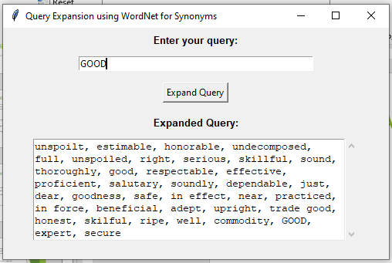
QUERY EXPANSION USING WORDNET FOR SYNONYMS
Implementation

Slide 6
THANK YOU

